Slide 1

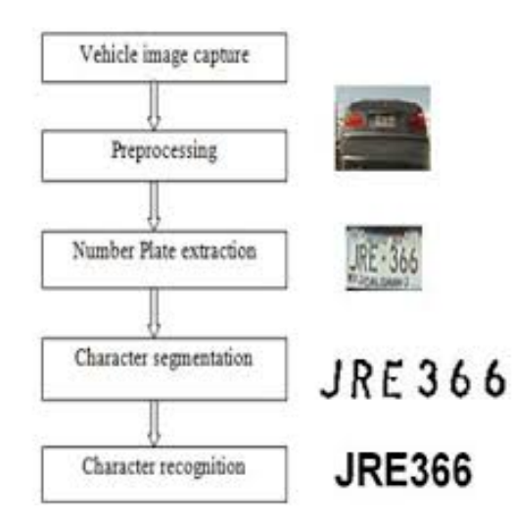
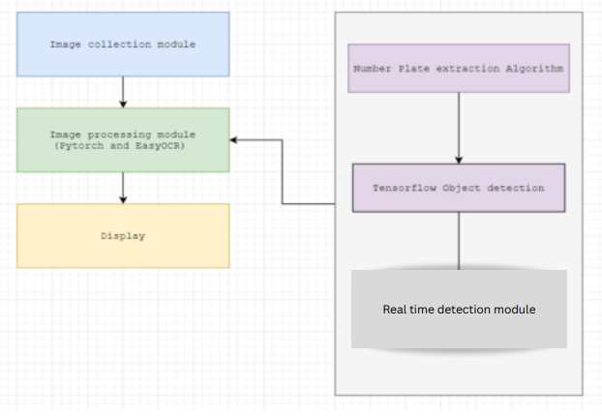
AI-BASED BLINDNESS DETECTION SYSTEM
RITHANYA M, VASUDHARINI V J
22011101090, 22011101120
Dr. U Padmavathi, Asst. Professor, CSE Dept
OVERVIEW
FUTURE SCOPE
FUNCTION MODULE
Due to increasing number of vehicles, the modern city needs to establish the effective automatic traffic system for the management of the traffic law enforcement. Number plate recognition leads the significant role in this condition. We are using AI to detect license plates from images and in real-time from video, Apply an Easy OCR to license plates to extract the plate number, and Save license plates detected for future analysis and searching. The detection and recognition accuracy can be achieved by using leveraging technology such as Tensor Flow
1. Real-time Traffic Management: Integration into traffic management and surveillance networks for immediate responses to violations and congestion.
2. Machine Learning Enhancement: Ongoing machine learning training to improve recognition capabilities in diverse environments.
3. Data Analytics: Leverage the structured database for traffic analytics, urban planning, and trend identification.
4. Enhanced Security: Application in security and law enforcement, tracking stolen vehicles and criminal identification.
5. User-Friendly Interfaces: Development of streamlined interfaces for widespread adoption.
6. Scalability: Ability to accommodate increased traffic and urban growth.
PROBLEM STATEMENT
Modern cities, grappling with growing traffic volumes, require a robust Automatic Number Plate Recognition (ANPR) system. This system must accurately detect and recognize license plates from images and real-time video, extract plate numbers, and store the data for analysis. It should, meet the challenges posed by increasing vehicle numbers and safety demands in urban areas.
MODULES USED
MODULES AND LIBRARIES
OpenCV
Tensor flow object detection
Easy OCR
tesseract
Matplotlib
*
CONCLUSION
The ANPR system represents a leap forward in automated traffic management and security solutions. It not only streamlines developer efforts but also opens new avenues for innovation in AI, machine learning, and urban infrastructure development, ushering in a promising era of more efficient and intelligent cities.

